Slide 1
“Teach A Level Maths”
Vol. 1: AS Core Modules
30: Sequences and Series
© Christine Crisp

Slide 2
Module C1
Module C2
Edexcel
AQA
MEI/OCR
OCR
"Certain images and/or photos on this presentation are the copyrighted property of JupiterImages and are being used with permission under license. These images and/or photos may not be copied or downloaded without permission from JupiterImages"

Slide 3

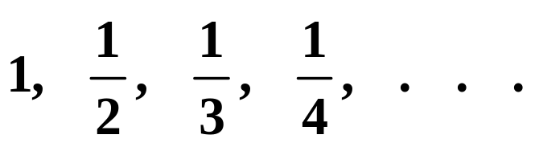

Examples of Sequences
e.g. 1
e.g. 2
e.g. 3
A sequence is an ordered list of numbers
The 3 dots are used to show that a sequence continues

Slide 4

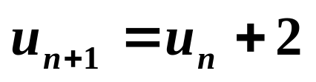

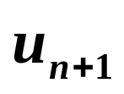

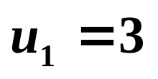
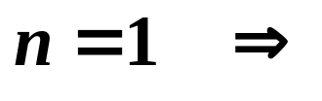
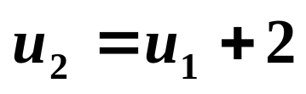

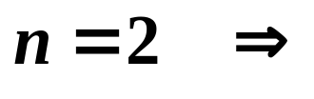
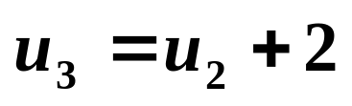
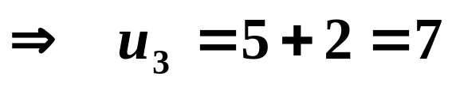
Recurrence Relations
Can you predict the next term of the sequence
?
11
Suppose the formula continues by adding 2 to each term.
The formula that generates the sequence is then
where and are terms of the sequence
is the 1st term, so
etc.

Slide 5
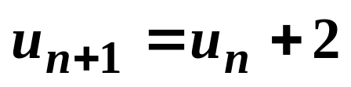
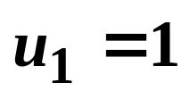

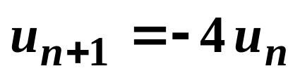
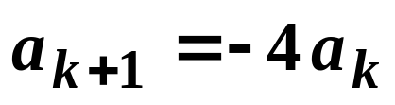
Recurrence Relations
A formula such as is called a recurrence relation
e.g. 1 Give the 1st term and write down a recurrence relation for the sequence
Solution:
1st term:
Recurremce relation:
Other letters may be used instead of u and n, so the formula could, for example, be given as

Slide 6
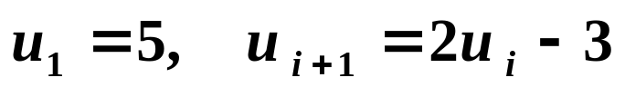
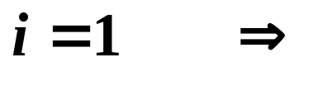
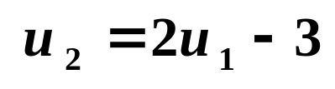

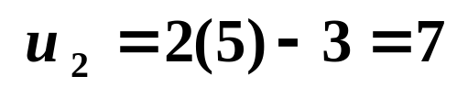
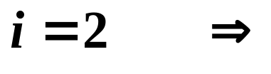
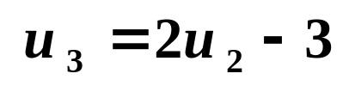
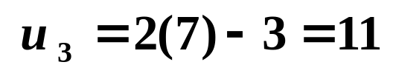
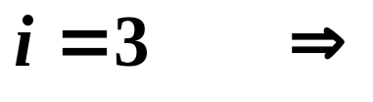
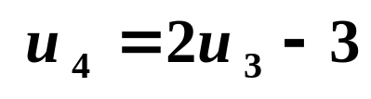


Recurrence Relations
e.g. 2 Write down the 2nd, 3rd and 4th terms of the sequence given by
Solution:
The sequence is

Slide 7
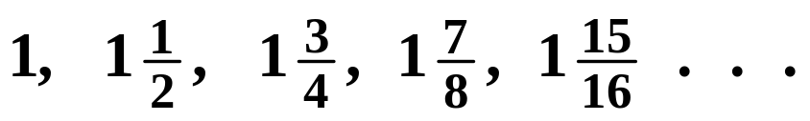
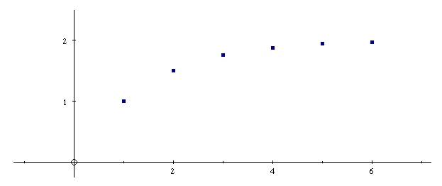


Properties of sequences
Convergent sequences approach a certain value
e.g. approaches 2

Slide 8
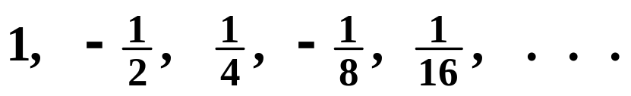
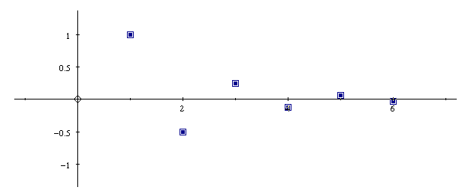
Properties of sequences
Convergent sequences approach a certain value
e.g. approaches 0
This convergent sequence also oscillates

Slide 9

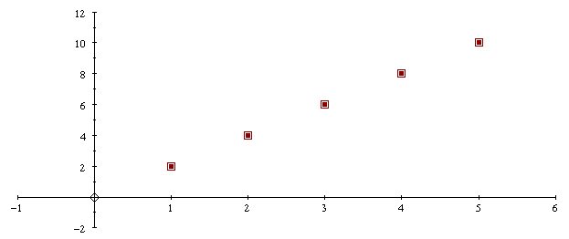
Properties of sequences
Divergent sequences do not converge
e.g.

Slide 10

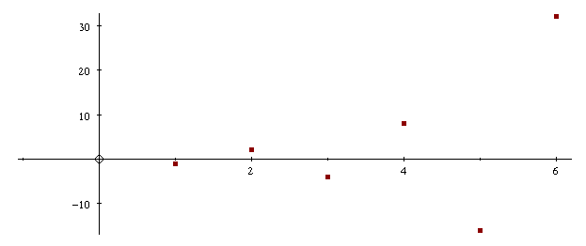
Properties of sequences
Divergent sequences do not converge
e.g.
This divergent sequence also oscillates

Slide 11
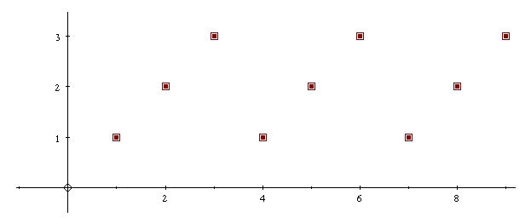
e.g.
Properties of sequences
Divergent sequences do not converge
This divergent sequence is also periodic

Slide 12
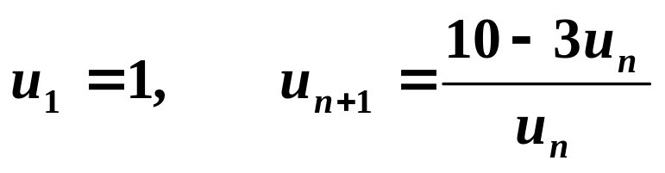
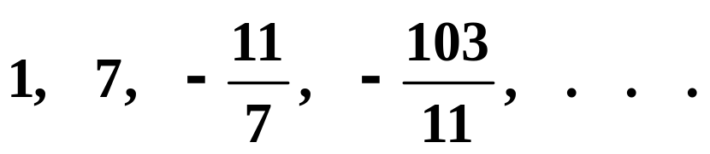
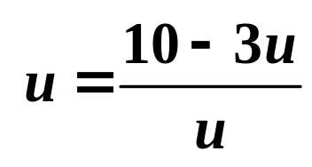
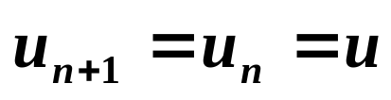
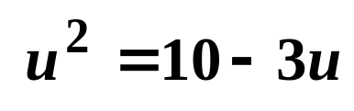
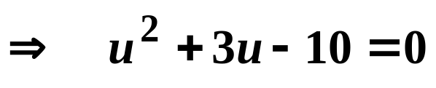


Convergent Values
It is not always easy to see what value a sequence converges to. e.g.
The sequence is
To find the value that the sequence converges to we use the fact that eventually ( at infinity! ) the ( n + 1 ) ^{th} term equals the n ^{th} term.
Let . Then,
Multiply by u :

Slide 13

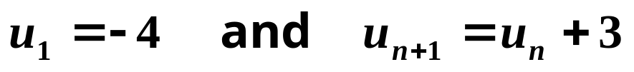

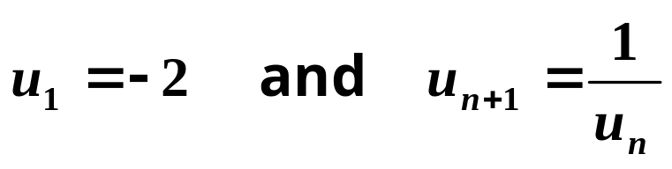
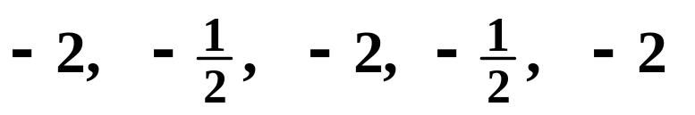
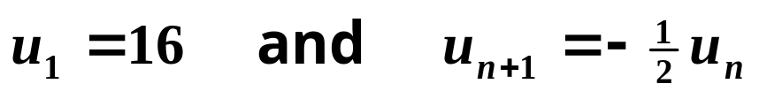

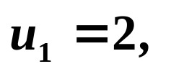
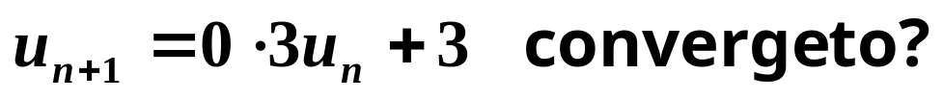
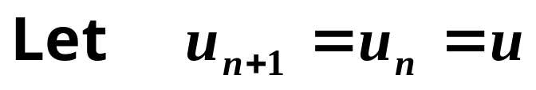
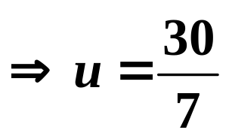
Exercises
1. Write out the first 5 terms of the following sequences and describe the sequence using the words convergent, divergent, oscillating, periodic as appropriate
(a)
Ans:
Divergent
(b)
Ans:
Divergent
Periodic
(c)
Ans:
Convergent
Oscillating
2. What value does the sequence given by

Slide 14
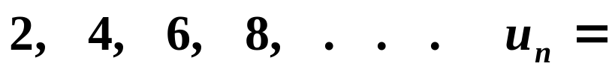

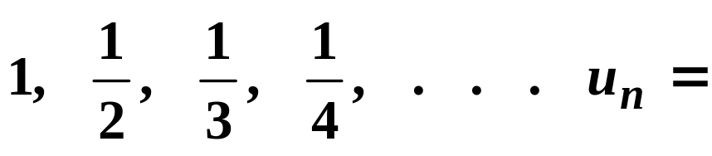

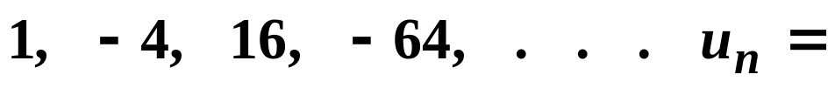
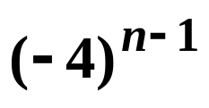
General Term of a Sequence
Some sequences can also be defined by giving a general term. This general term is usually called the n^{th} term.
e.g. 1
e.g. 2
e.g. 3
The general term can easily be checked by substituting n = 1, n = 2, etc.

Slide 15
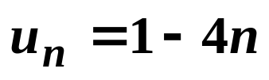

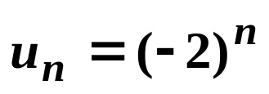

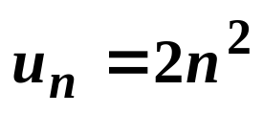










Exercises
1.
Write out the first 5 terms of the following sequences
(a)
(b)
(c)
(d)
2.
Give the general term of each of the following sequences
(a)
(b)
(c)
(d)

Slide 16



Series
When the terms of a sequence are added, we get a series
The sequence
gives the series
Sigma Notation for a Series
A series can be described using the general term
e.g.
can be written
last value of n
1st value of n
is the Greek capital letter S, used for Sum

Slide 17










Exercises
1. Write out the first 3 terms and the last term of the series given below in sigma notation
(a)
n = 1
n = 2
n = 20
(b)
2. Write the following using sigma notation
(a)
(b)

Slide 18


Slide 19
The following slides contain repeats of information on earlier slides, shown without colour, so that they can be printed and photocopied.
For most purposes the slides can be printed as “Handouts” with up to 6 slides per sheet.

Slide 20
Recurrence Relations
A formula such as is called a recurrence relation
e.g. 1 Give the 1st term and write down a recurrence relation for the sequence
Solution:
1st term:
Recurremce relation:
Other letters may be used instead of u and n, so the formula could, for example, be given as

Slide 21
Recurrence Relations
e.g. Write down the 2nd, 3rd and 4th terms of the sequence given by
Solution:
The sequence is

Slide 22
Properties of sequences
Convergent sequences approach a certain value
e.g. approaches 2

Slide 23
Properties of sequences
Convergent sequences approach a certain value
e.g. approaches 0
This convergent sequence also oscillates

Slide 24
Properties of sequences
Divergent sequences do not converge
e.g.
This divergent sequence also oscillates

Slide 25
e.g.
Properties of sequences
Divergent sequences do not converge
This divergent sequence is also periodic

Slide 26
Convergent Values
It is not always easy to see what value a sequence converges to. e.g.
The sequence is
To find the value that the sequence converges to we use the fact that eventually ( at infinity! ) the ( n + 1 ) ^{th} term equals the n ^{th} term.
Let . Then,
Multiply by u :

Slide 27
General Term of a Sequence
Some sequences can also be defined by giving a general term. This general term is usually called the n^{th} term.
e.g. 1
e.g. 2
e.g. 3
The general term can easily be checked by substituting n = 1, n = 2, etc.

Slide 28
Series
When the terms of a sequence are added, we get a series
The sequence
gives the series
Sigma Notation for a Series
A series can be described using the general term
e.g.
can be written
last value of n
1st value of n
is the Greek capital letter S, used for Sum

